Slide 1
Project-9
Equity Research News Tool
NextHikes Solutions
By - Rakshit A Solanki

Slide 2
Project Overview
Business and financial news plays an important role in understanding company performance and market developments.
Investors and analysts need relevant and timely information to make informed decisions.
This project uses NewsAPI to fetch the latest company related news articles.
Google Gemini AI and LangChain are used to analyze and summarize the collected news.
A Streamlit based web application provides an interactive interface for news research.

Slide 3
Problem Statement
Investors often need to search multiple websites to collect company related news.
Reading multiple news articles requires significant time and effort.
Important business developments can be difficult to identify from lengthy articles.
Manually analyzing positive and negative business impacts can be challenging.
The project aims to simplify news research through automated retrieval and AI-powered summarization.

Slide 4
Project Information
Project Components
  Project Name : Equity Research News Tool
  News Source : NewsAPI
  AI Model : Google Gemini
  AI Framework : LangChain
  Programming Language : Python
Main Features
  Company news search
  AI News Summarization
  Article Image Display
  Business News Analysis

Slide 5
News API Integration
NewsAPI is integrated to retrieve company related news articles.
Users can search using company names or business-related keywords.
Articles are retrieved in English language.
The relevancy sorting option helps retrieve relevant search results.
The application can request up to 10 articles per search.
Articles titles, descriptions, publication dates, sources and image URLs are collected.

Slide 6
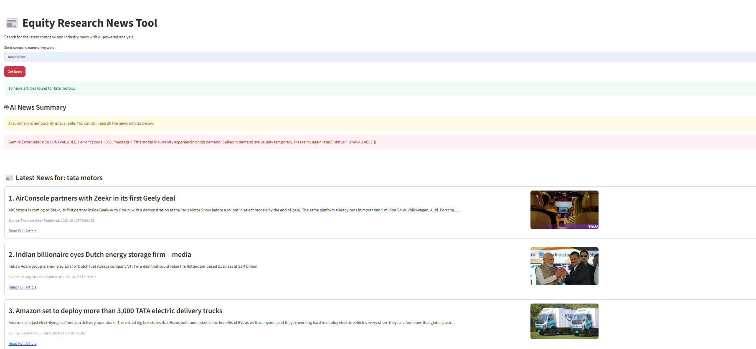
News Retrieval Output
The application displays the latest articles related to the entered search query.
Each article includes its headline and available description.
News source and publication date are displayed.
User can open the original article through the provided link.

Slide 7
LangChain Configuration
LangChain is used to connect the AI model with the application.
A Prompt template is created to structure the news analysis instructions.
The company name and collected news articles are passed to the prompt.
The prompt guides the AI model to identify important business developments.
The AI response is retuned to the Streamlit application.
LangChain manages the interaction between the prompt and AI model.
The generated summary is presented in a clear and structured format.

Slide 8
Google Gemini AI Integration
Google Gemini is used as the large language model (LLM).
Gemini analyzes the collected news article information.
The model identifies important news updates and business developments.
It evaluates possible positive & negative business impacts.
It generates a concise conclusion in simple English.
Gemini uses the instructions provided through the LangChain prompt template.
The analysis helps users understand the overall business impact of the collected news.

Slide 9
News Summarization Process
The user enters a company name or keyword.
NewsAPI retrieves relevant articles.
Article titles and descriptions are extracted.
The selected article information is passed to the LangChain prompt.
Google Gemini analyzes the provided information.
The generated summary is displayed in the Streamlit application.

Slide 10
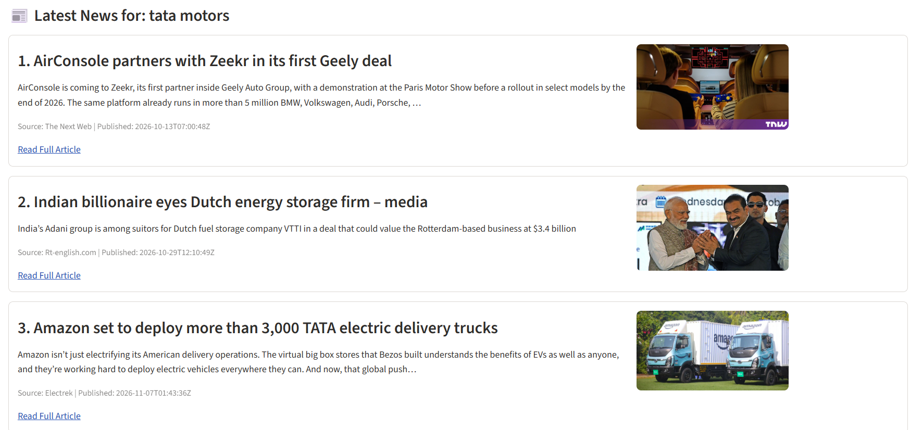
Article Image Processing
The application first checks the original image URL provided by NewsAPI.
If the original image is unavailable, it checks the article webpage for an Open Graph or Twitter image.
If no suitable image is found, it searches Wikimedia Commons for a related image.
Image title relevance is checked using keyword matching.

Slide 11
Web Application Development
Streamlit is used to build the interactive web interface.
Users can enter a company name or keyword in the search field.
The get news button starts the retrieval process.
The application displays AI summaries and relevant news articles.
The interface includes warning and error messages for better usability.
News articles are displayed with their titles, descriptions, sources & publication dates.
Users can access the original news articles through the provided links.

Slide 12
Business Insights
The tool helps users monitor company related news, market trends & business developments.
Relevant news articles make it easier to follow important updates from different sources.
AI generated summaries reduce the time and effort required to read multiple news articles.
Positive and Negative developments can be identified from the collected news information.
The tool helps users understand how recent news may affect a company’s business activities.

Slide 13
Conclusion
The project successfully combines NewsAPI, LangChain, Google Gemini AI & Streamlit into one application.
Automated news retrieval simplifies the process of collecting company-related information.
Article image retrieval improves the visual presentation and overall application experience.
The interactive Streamlit interface makes the tool simple and user friendly.
The project demonstrates the practical application of Large Language Models (LLM) in news research and business analysis.

Slide 14
Reference Links Used For Learn
https://newsapi.org/docs/client-libraries/python?utm
https://docs.streamlit.io/get-started/tutorials/create-an-app?utm
https://langchain-opentutorial.gitbook.io/langchain-opentutorial/04-model/06-googlegenerativeai?utm

Slide 15
Thank You

